Slide 1
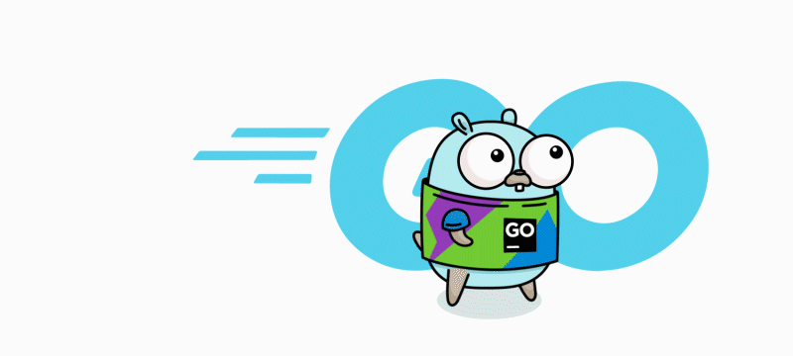
Evaluation of The GO Programming Language
Group：12
Jingzhou Shen, Jie Zhu, Shudong Lai
Notes:
Logo is a gopher created by Renee.

Slide 2
Evaluation Criteria
Community Environment
User Convenience
Programming Paradigms
Scalability
Versatility
Interactivity
Current Problem

Slide 3
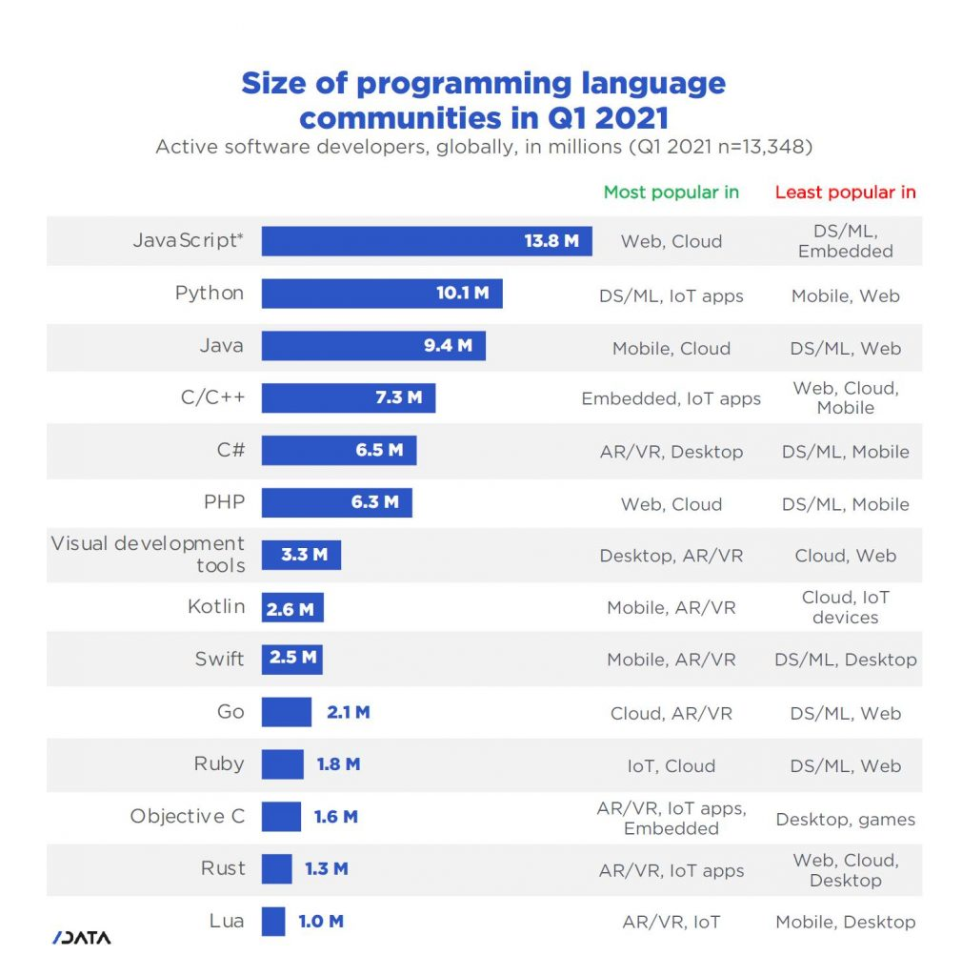
Community Environment
From SlashData

Slide 4
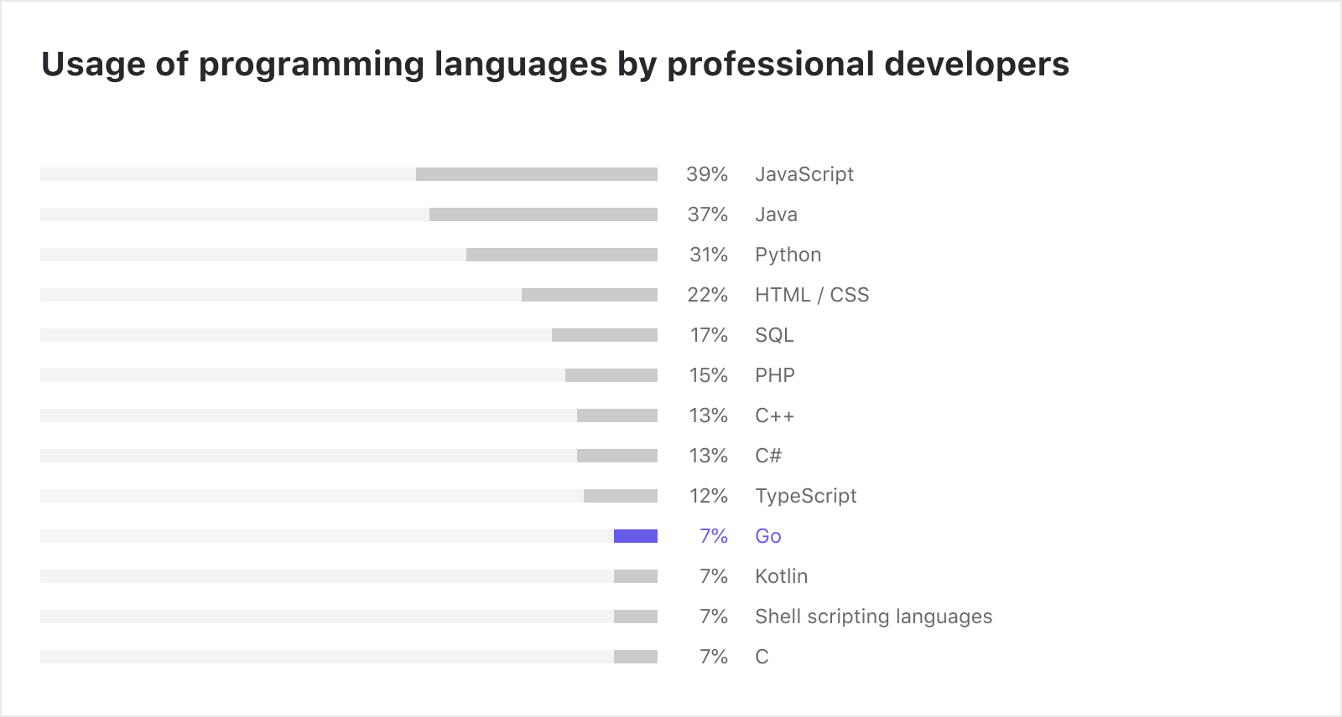
Community Environment
Overall, there are about 1.1 million professional Go developers who use Go as a primary language.
But that number is possibly closer to 2.7 million if we include professional developers who mainly use other programming languages but also do a bit of Go on the side.

Slide 5
User Convenience
Communication
Github Project
Tutorial

Slide 6
User Convenience: Communication
It’s measured by the number of questions on Stack Overflow.
Collected on Oct. 27th, 2021

Slide 7
User Convenience: Github Project
Collected on Oct. 27th, 2021

Slide 8
User Convenience: Tutorial
We select two ways to measure tutorial: the number of online courses on Coursera and the books on Amazon.
Courses on Coursera
 | JavaScript | Python | Java | C++ | R | Go | Swift | Ruby
Amount | 221 | 915 | 1468 | 116 | 1687 | 2532 | 199 | 2
Books on Amazon
 | JavaScript | Python | Java | C++ | R | Go | Swift | Ruby
Amount | over 10,000 | over 20,000 | over 30,000 | over 10,000 | over 20,000 | over 7,000 | over 1,000 | over 4,000

Slide 9
Programming Paradigms
Structured Procedural Paradigm
Object Oriented Paradigm
Functional Paradigm

Slide 10
Structured Procedural Paradigm
Modules
A module is a collection of Go packages stored in a file tree with a go.mod file at its root. The go.mod file defines the module’s module path, which is also the import path used for the root directory, and its dependency requirements, which are the other modules needed for a successful build. Each dependency requirement is written as a module path and a specific semantic version.

Slide 11
Structured Procedural Paradigm
This post walks through a sequence of common operations that arise when developing Go code with modules:
Creating a new module.
Adding a dependency.
Upgrading dependencies.
Adding a dependency on a new major version.
Upgrading a dependency to a new major version.
Removing unused dependencies.

Slide 12
Structured Procedural Paradigm
Functions
A function is a group of statements that together perform a task.
The general form of a function definition in Go programming language is as follows:
func function_name( [parameter list] ) [return_types] {
body of the function
}

Slide 13
Structured Procedural Paradigm
A function definition in Go programming language consists of a function header and a function body. Here are all the parts of a function −
Func − It starts the declaration of a function.
Function Name − It is the actual name of the function. The function name and the parameter list together constitute the function signature.
Parameters − A parameter is like a placeholder. When a function is invoked, you pass a value to the parameter. This value is referred to as actual parameter or argument. The parameter list refers to the type, order, and number of the parameters of a function. Parameters are optional; that is, a function may contain no parameters.
Return Type − A function may return a list of values. The return_types is the list of data types of the values the function returns. Some functions perform the desired operations without returning a value. In this case, the return_type is the not required.
Function Body − It contains a collection of statements that define what the function does.

Slide 14
Structured Procedural Paradigm
Block Scope Block scoping means declaring a variable, not just inside a function, but around any curly brackets like if statements or loops.
Like local variables and global variables. And Local variables have the first priority.
v := 1 { v := 2 fmt.Println(v) //2 } fmt.Println(v) //1

Slide 15
Structured Procedural Paradigm
Structured control flow instead represents code as an ordered sequence of basic blocks and scoped control flow constructs (if/else, while/for, switch, break, continue, …).
if condition
//Executable code
}else if condition{
//Executable code
} else{
//Executable code
}
func main() {
//Nested for loop
for i := 1; i <= 5; i++ {
for j := 1; j <= 10; j++ {
fmt.Print("\t")
fmt.Println(j * i)
}
}
//for with no condition
m := 0
for {
fmt.Println(m)
if m >= 10 {
break
} m++
}
//for as a while loop
k := 0
for k < 10 {
fmt.Println(k)
if k >= 10 {
break
}
k++
}

Slide 16
Object Oriented Paradigm
ADTs / Class
There are no classes in Go, but Go has struct types，Structs are user-defined types. Struct types (including methods) provide services similar to classes in other languages.
Encapsulation
One of the best features of Go: capitalized fields, methods and functions are public. All the other fields are local to the package and not exported. With a single look you know if something is public or private. There’s no protected because there is no inheritance.

Slide 17
Object Oriented Paradigm
There is no concept of inheritance.、
When declaring a struct we can add an unnamed (anonymous) field, which causes its fields and its methods to be exposed on the struct. This is called struct embedding:
func (a *Animal) Move() {
fmt.Println("Animal moved")
}
func (a *Animal) SayAge() {
fmt.Printf("Animal age: %d\n", a.Age)
}
func main() {
d := Dog{}
d.Age = 3
d.Move()
d.SayAge()
type Dog struct {
Animal
}
type Animal struct {
Age int
}

Slide 18
Object Oriented Paradigm
Polymorphism
Go interfaces are very different, and one key concept is that interfaces are satisfied implicitly.
In Go, a type automatically satisfies any interface that specifies a subset of its methods.
Interfaces elegantly provide polymorphism: by accepting an interface, you declare to accept any kind of object satisfying that interface.

Slide 19
Functional Paradigm
Pure Functions
a pure function should return values only based on the arguments passed and should not affect or depend on global state.
func sum(a, b int) int {
return a + b
}

Slide 20
Functional Paradigm
Anonymous Functions
An anonymous function is a function without a name.
func main() {
a := func() {
fmt.Println("Func A")
}
a()
}
Notes:
First-class Functions First-class functionsmeans you can assign functions to variables, pass a function as an argument to another function or return a function from another. Go supports this and hence makes concepts like closures, currying, and higher-order-functions easy to write.

Slide 21
Functional Paradigm
Closures
A closure is a mechanism present in some programming language that allows functions to “remember” the variables that were present in their outer scope when they were defined.
func main() {
f := closure(10)
res1 := f(1)
fmt.Println(res1)
res2 := f(2)
fmt.Println(res2)
}
func closure(x int) func(int) int {
fmt.Printf("%p \n", &x)
return func(y int) int {
fmt.Printf("%p \n", &x)
return x + y
}
}
//It can be seen that the address of x is the same for 3 times

Slide 22
Scalability
Scalability means that the system which is written by the language have a reasonable way to deal with the growth of the system (like data volume, traffic, complexity)
One way to achieve: Concurrency

Slide 23
Scalability
Go has a built-in concurrency mechanism – goroutine
1) Kind like thread
2) Scheduled and managed by the Go runtime—go language itself to achieve a set of scheduling system
3) The Go program intelligently allocates the tasks in Goroutine to each CPU
Compare to Java/C++:
1) maintain a thread pool ourselves
2) wrap task after task ourselves
3) schedule threads to perform tasks and maintain context switches ourselves

Slide 24
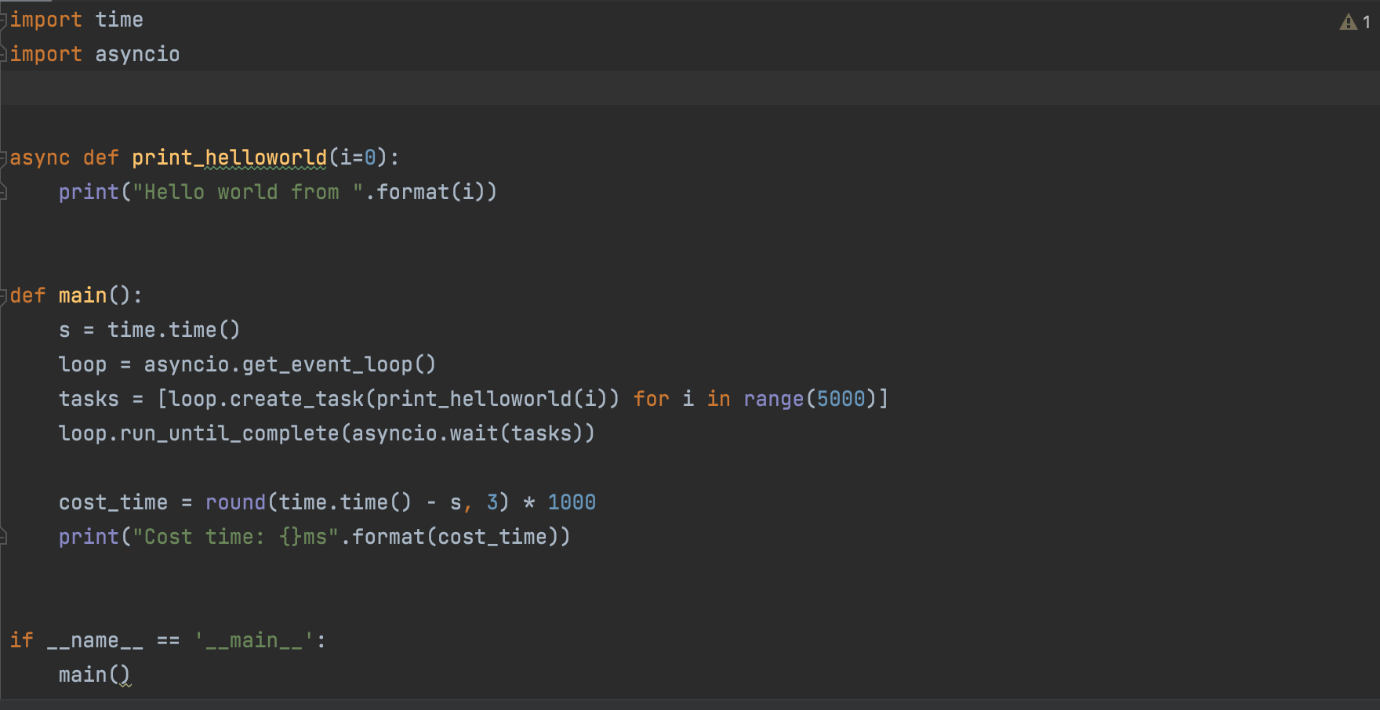
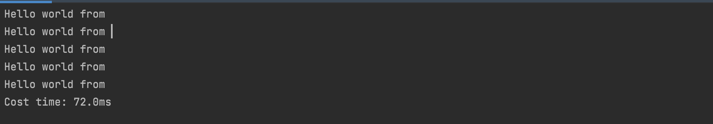
Scalability
Compared to Python:
Using Asyncio to implement concurrency

Slide 25
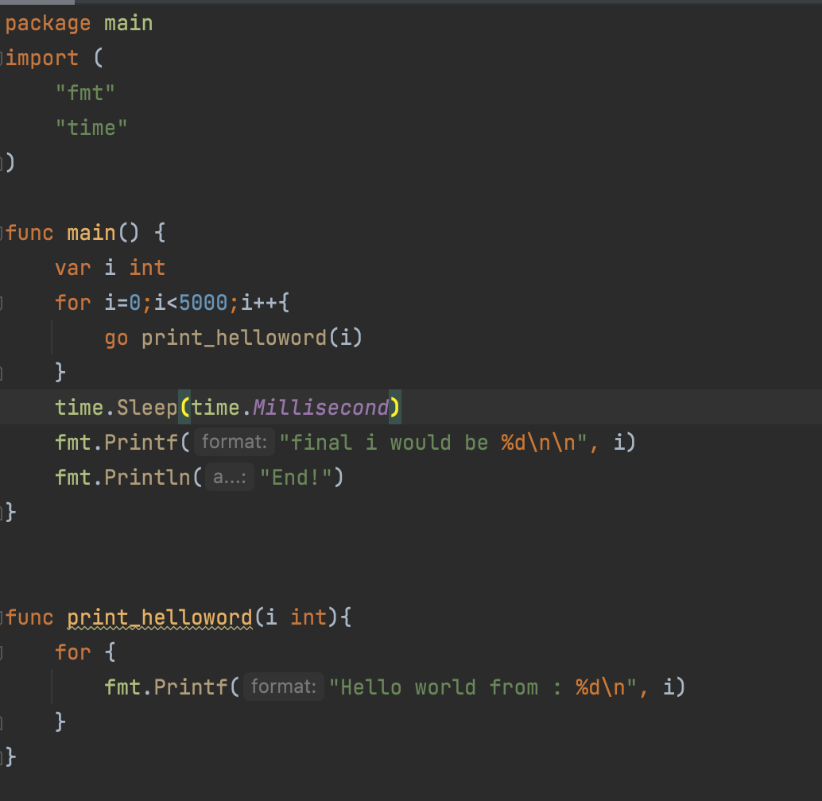
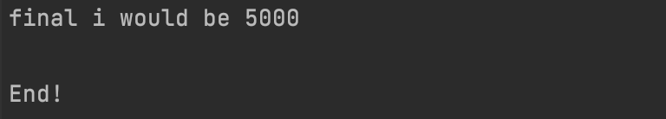
Scalability

Slide 26
Scalability
Go 2 Draft Design was published in 2018, and one of goals of this new version is to focus on the scalability
1) error checking to be more lightweight, increase the likelihood that developers will handle errors.
2) Make error checking easier and less error-prone to improve error handling and robustness of programs, print errors with extra detail in a standard format
3) Generics, which to extent to a bigger code base, The problem of writing the Go library, which abstractions unnecessary type details, is solved by allowing parameter polymorphism with type parameters

Slide 27
Versatility
Firstly the goal of the Go language is to improve development efficiency in multi-core, networked machines, and large codebases.
At Google at the time, designers wanted to address the drawbacks of other languages, but retain their advantages, such as:
Static typing and runtime efficiency. (e.g. C++)
Readability and ease of use. (e.g. Python and JavaScript)
High performance networking and multi - process.

Slide 28
Versatility
Server programming
Go is a good place to do things you used to do in C or C++, such as logging, data packaging, virtual machine processing, file systems, etc.
Network programming
Web applications, API applications, download applications. Go built-in NET/HTTP package.
Distributed systems, database agents, middleware, etc.
Database operations
Development of cloud platform, used very wildly

Slide 29
Versatility
Cloud computing infrastructure
Representative projects: Docker, Kubernetes, ETCD, Consul, Cloudflare CDN, etc.
Based on the software
Representative projects: TIDB, InfluxDB, CockroachDB, etc.
Micro service
Representative projects: Go-Kit, Micro, TYPHON of Monzo Bank, Bilibili, etc.
Internet infrastructure
Representative projects: Ethereum, Hyperledger, etc

Slide 30
Interactivity
Go calls C/C++ :
C: Using cgo tools; Cgo replaces the Go compiler to produce Go and C code that can be combined in the same package. Cgo is typically used to create separate C code packages in real development
just using ‘ import “C”’, sometimes need ‘import “unsafe”’
C++ : Calls C++ interfaces by implementing a layer of encapsulated C interfaces

Slide 31
Interactivity
Go interact with JavaScript
Using AJAX technology, it is possible to update the technology of parts of a web page without having to reload the entire page
Using WebSocket communication technology, the browser and server can provide a two-way channel based on TCP connection, so that the exchange of data is more simple

Slide 32
Interactivity
Go interact with Python
Golang and Python can currently convert golang objects and Python objects to C objects through Golang's CGO and Python's ctypes respectively, thus completing the interaction by compiling and calling C's dynamic linking library

Slide 33
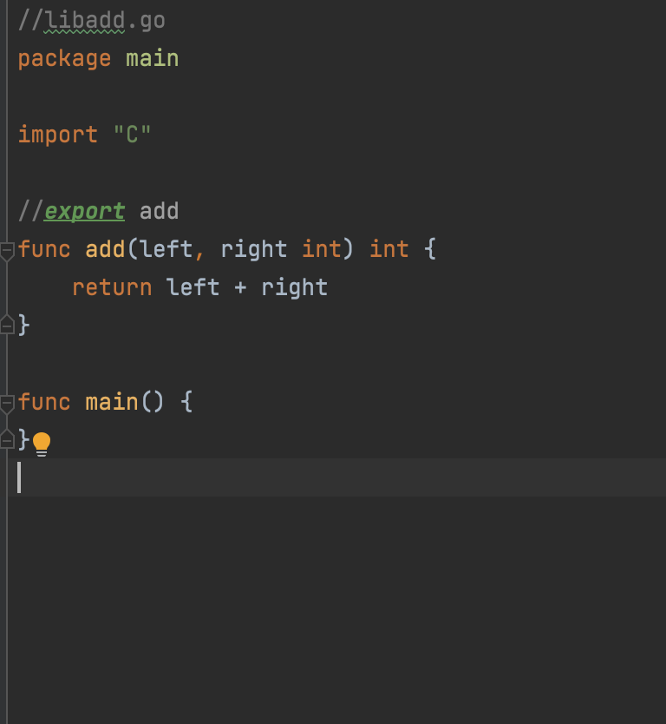
Interactivity: Example
Implement an add function(data type: int)
Compile to a. So file in c-shared mode：
go build -buildmode=c-shared -o libadd.so libadd.go

Slide 34
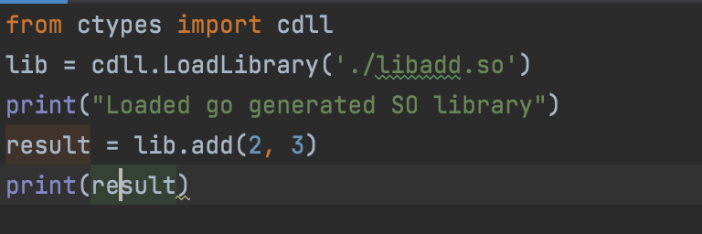
Interactivity
Python use .So file
Result would be 5

Slide 35
Current Problem
Poor Library Support
Library support for Go is spotty. Our API integrates with Contentful, which does not have an officially supported Go SDK.
No Generics
It means a decreased level of reuse in your code. While Go has first-class functions, if you write functions like “map”, “reduce”, or “filter” that operates on a collection of one type, you can’t reuse those same functions for a collection of a different type. This hurts productivity and maintainability.
Fractured Dependency Management
For a long time Go did not have a stable, official package manager. After years of begging from the community, the Go project has recently released godep.
BlaBlaBla…

Slide 36
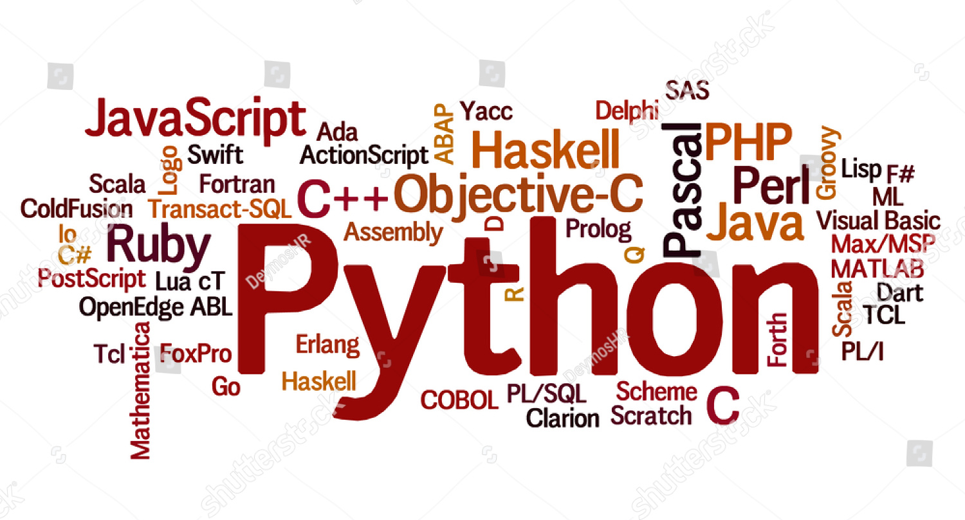
Our Project
Spider ＆ Data Visualization website
Collect the crucial data of Github Trending to analyze the popularity of different programming languages, popular area and so on, and make a website to visualize these data(like Tag-cloud, chart etc.).
Technology might use
Spider
Goroutine
Beego（web framework）
Go-echarts
BlaBlaBla…

Slide 37
Question

Slide 38

Thanks for listening！

